Slide 1





UNIVERSITY MANAGEMENT SYSTEM
SOFTWARE ENGINEERING LAB CSE305L
GROUP - 6
1

Slide 2

TEAM MEMBERS
Haril P AP21110011365
Lakshman A AP21110011379
Udhay K AP21110011381
Srikar M AP21110011400
2

Slide 3

INTRODUCTION
DESCRIPTION
USER ROLES
TECHNOLOGIES USED
SRS
FUNCTIONAL AND NON-FUNCTIONAL REQUIREMENTS
FUNCTIONALITIES
TESTING
CONCLUSION
LIMITATIONS AND FUTURE WORKS
Contents
3

Slide 4


INTRODUCTION
In today's fast-paced academic world, the University Management System (UMS) is like a portal for schools and colleges. It's a high-tech tool that makes running educational institutions much smoother. By using the latest technology, it helps schools handle paperwork faster, makes students' lives easier, and gets teachers more involved. In a world where everyone wants things to be quick and easy, the UMS is like a one-stop-shop for schools, making things simpler for everyone involved.
The University Management System (UMS) is advanced software that helps universities run smoothly. It uses technology and expertise to manage students, faculty, and administrative tasks efficiently. This makes it easier to handle things like enrolment, course management, and faculty schedules. By doing this, the UMS creates an environment where academic work can flourish, leading to better outcomes for everyone involved in the educational process.
4

Slide 5

DESCRIPTION
The University Management System (UMS) is a comprehensive web-based platform designed to streamline and modernize administrative workflows within academic institutions. The system caters to three main user roles: administrators, faculty members, and students, providing tailored features and functionalities for each group.
Administrators have access to comprehensive dashboards for managing user accounts, course offerings, scheduling sessions, and generating detailed reports.
5

Slide 6



Faculty members can take attendance, input grades, and access student records, facilitating efficient course management. Students benefit from features such as profile viewing, course enrollment, and attendance tracking, enhancing their academic experience.
The UMS leverages frontend technologies like HTML, Bootstrap, JavaScript, and React.js for intuitive user interfaces, while backend technologies such as MongoDB, Node.js, and Express.js ensure robust data management and server-side logic execution. The project focuses on optimizing user experiences, data security, and system scalability to meet the evolving needs of educational institutions in the digital age.
6

Slide 7




USER ROLES
ADMIN
STUDENT
TEACHER
Administrators use the Admin portal to manage student and faculty accounts, course offerings, schedules, faculty assignments to students and classes, and generate detailed reports.
Students can log in to their accounts to access a personalized dashboard where they can view their profile information, enrolled subjects, and attendance records
Faculty upon logging into their accounts can mark attendance for specific students in their classes, record marks or grades for assignments and exams, and access detailed student records
7

Slide 8










TECHNOLOGIES USED
Frontend
HTML, Bootstrap, Javascript, React.js
Backend
Node.js, Express.js
Database
MongoDB
8

Slide 9
SRS
A software requirements specification (SRS) is a document that describes what the software will do and how it will be expected to perform. It also describes the functionality the product needs to fulfill the needs of all stakeholders (business, users).
SRS document for the University Management System is attached below
Software Requirments Specification Document
9

Slide 10
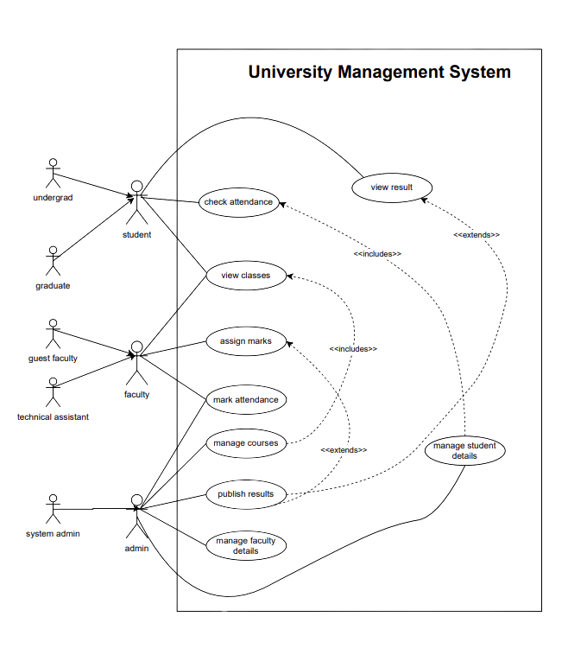

DESIGN
USE CASE DIAGRAM
10

Slide 11
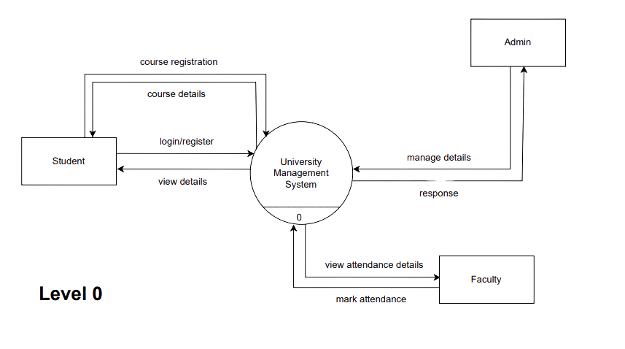
DATA FLOW DIAGRAM - LEVEL 0
11

Slide 12
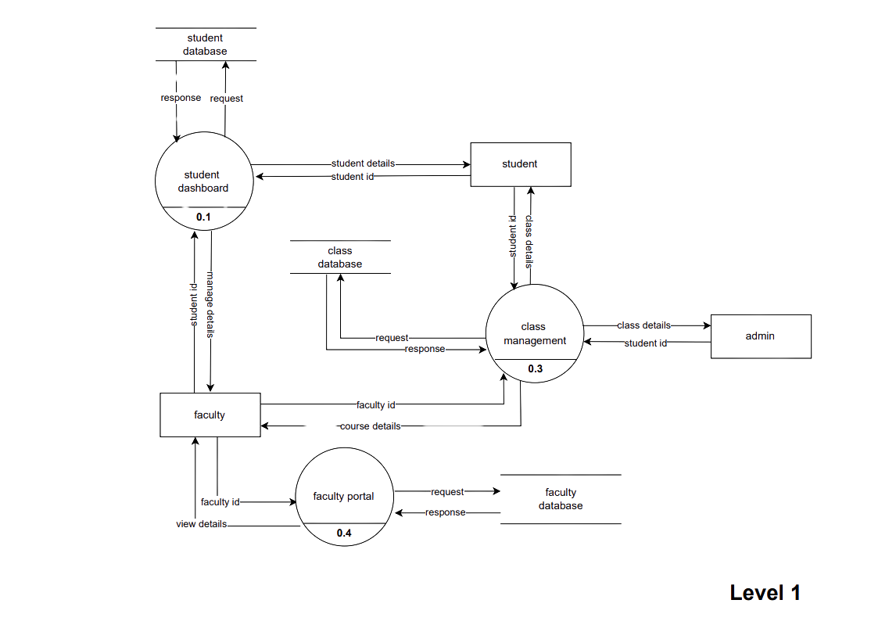
DATA FLOW DIAGRAM - LEVEL 1
12

Slide 13
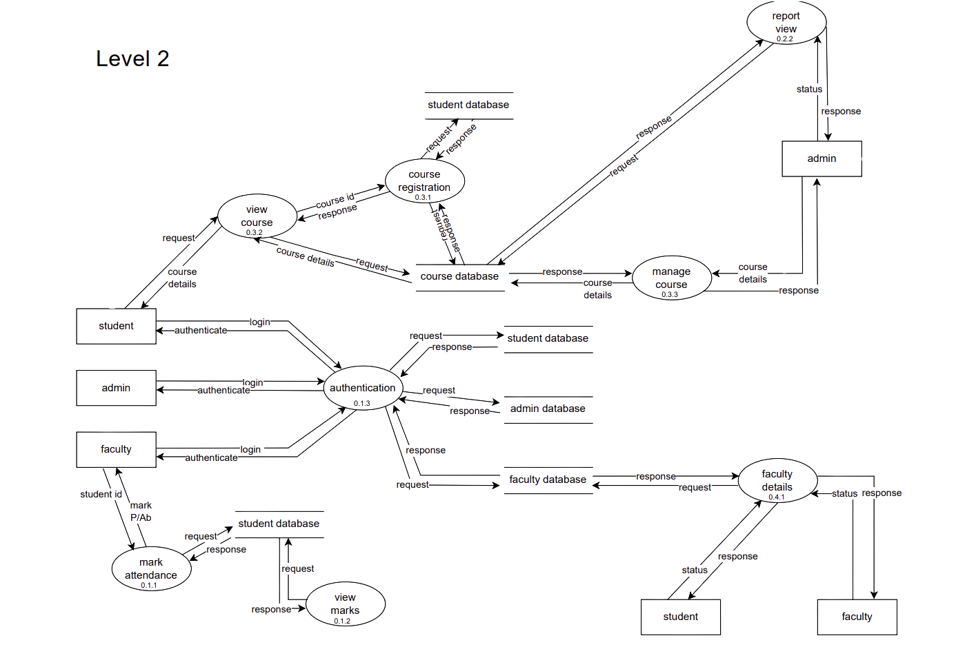
DATA FLOW DIAGRAM LEVEL - 2
13

Slide 14
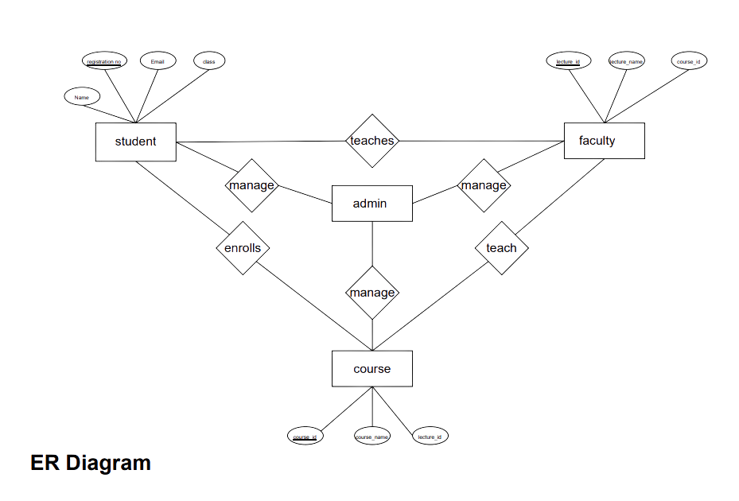
ENTITY RELATIONSHIP DIAGRAM
14

Slide 15
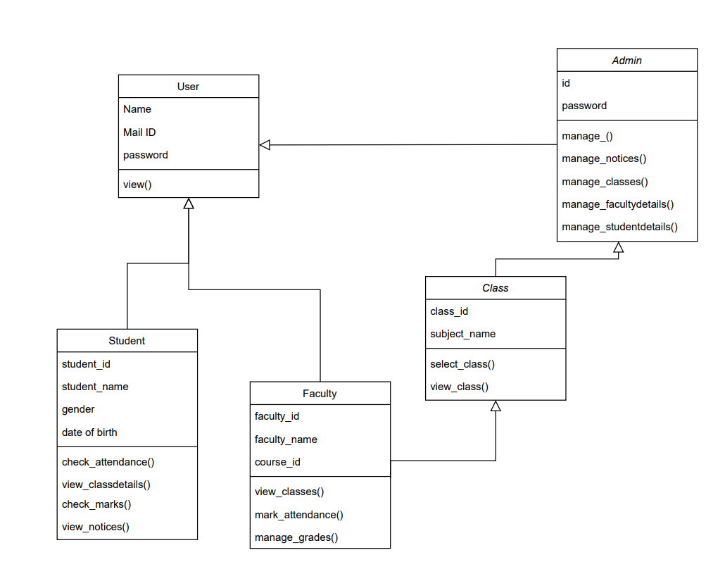
CLASS DIAGRAM
15

Slide 16
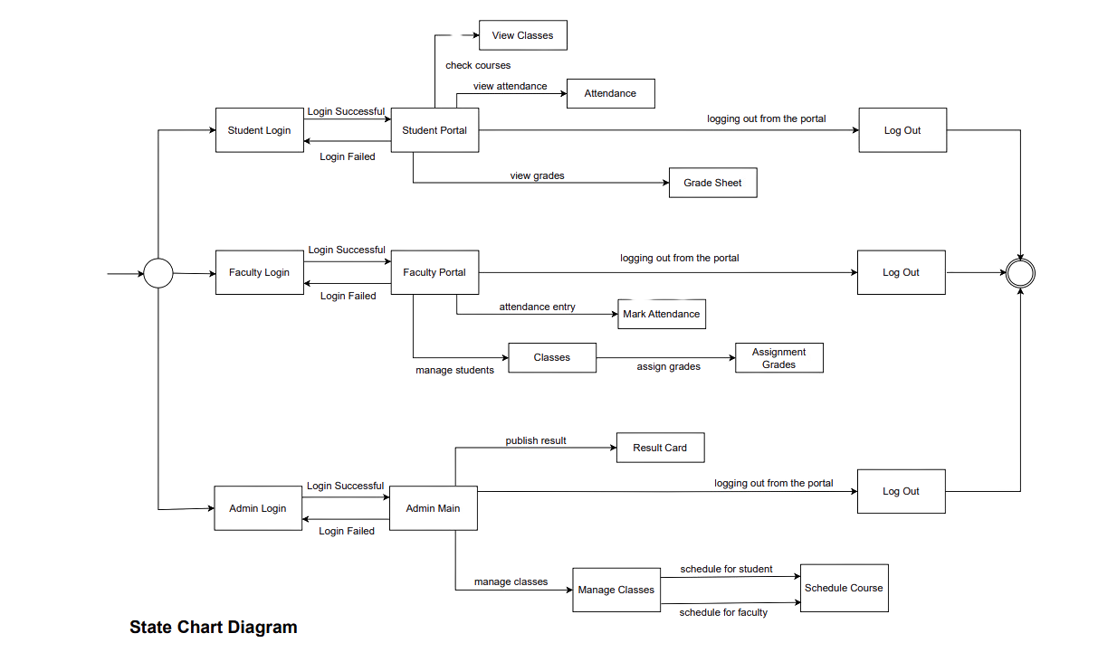
STATE CHART DIAGRAM
16

Slide 17
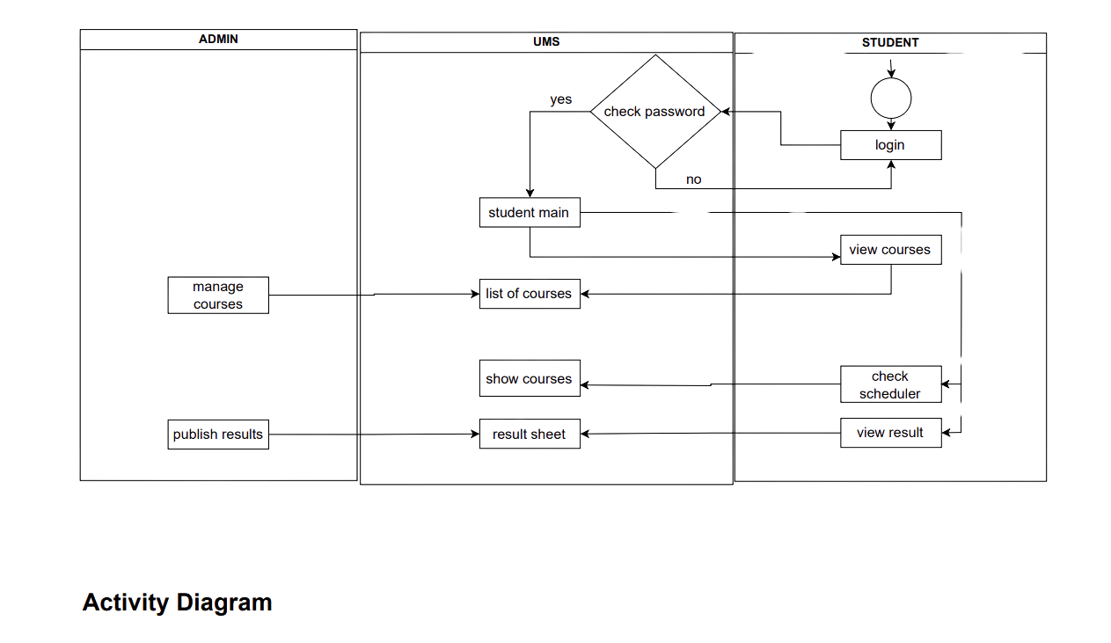
ACTIVITY DIAGRAM
17

Slide 18
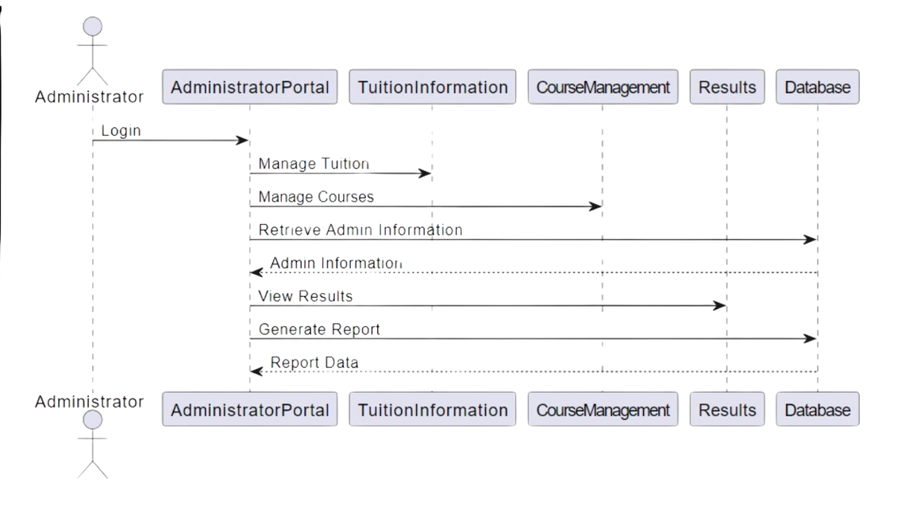
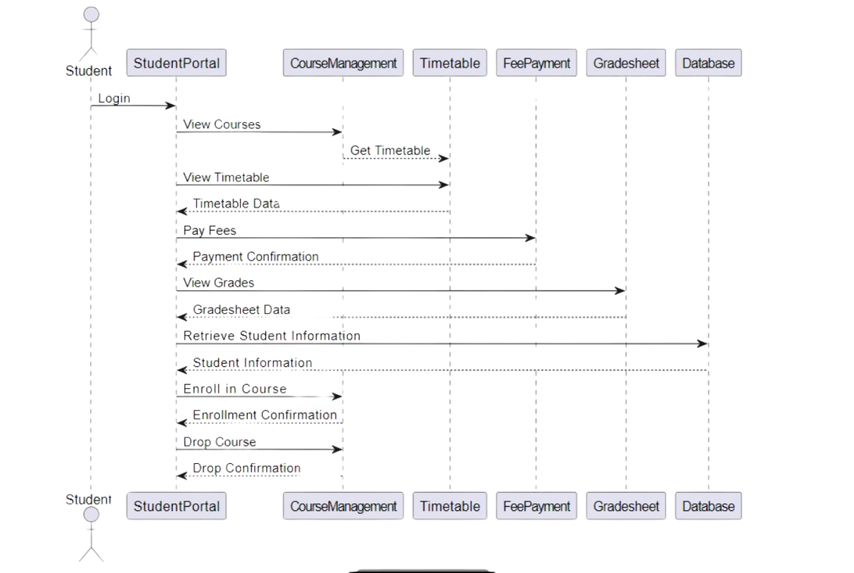
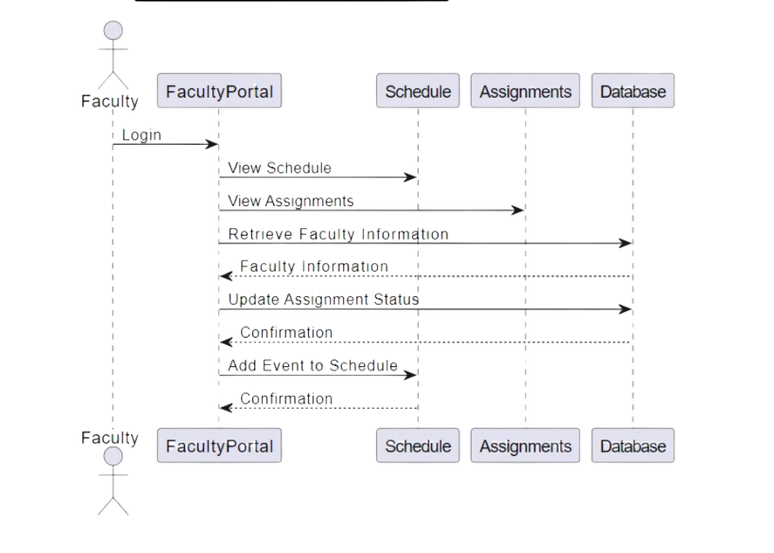
COLLABORATION DIAGRAM
18

Slide 19

FUNCTIONAL REQUIREMENTS
1. User Authentication and Authorization: Users must be able to authenticate securely using credentials (username/password).
2. Dashboard and User Profiles: Personalized dashboards for administrators, faculty, and students displaying relevant information.
3. Administrative Tools: Admin should be able to manage student faculty accounts, should be able to allot the faculty for students, schedule class hours and manage attendance.
4. Attendance Tracking and Grading: Automated attendance tracking for faculty and students with manual entry options. - Grading tools for faculty members to enter grades or marks.
5. Course Management: Course management by the admin and the detailed course descriptions, class and faculty information to be available for students.
19

Slide 20

NON-FUNCTIONAL REQUIREMENTS
The system's database must have the capability to store many student records. The system should be scalable and able to handle many concurrent users.
The system must be user-friendly and accessible to users with varying levels of technical expertise.
The system should be secure, with strong encryption and user authentication.
The system should be compatible with a range of web browsers and devices.
The software must have a reliable backup and recovery plan to ensure that data is not lost in case of a disaster or system failure.
20

Slide 21
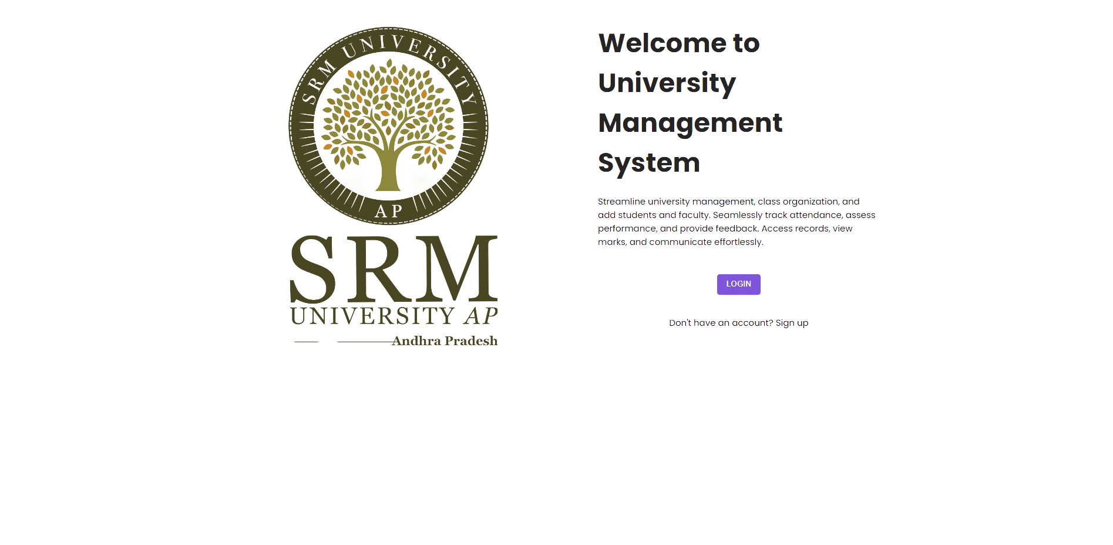
FUNCTIONALITIES
LANDING PAGE
21

Slide 22
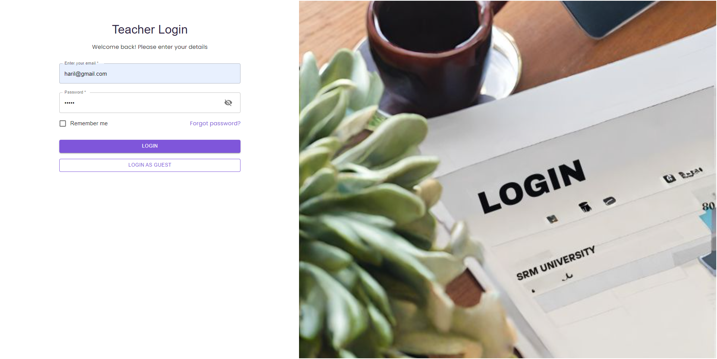
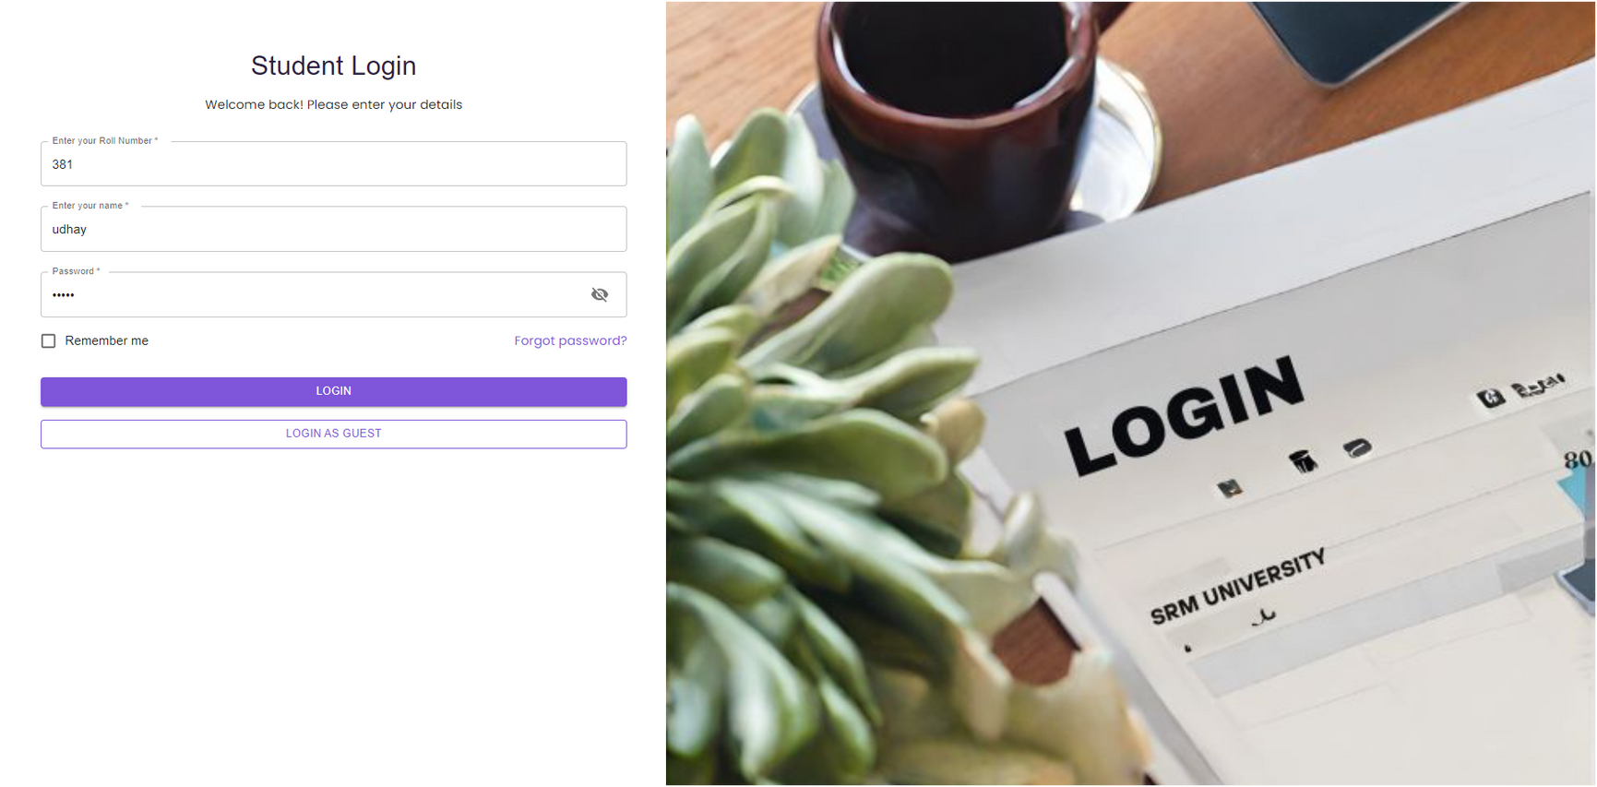
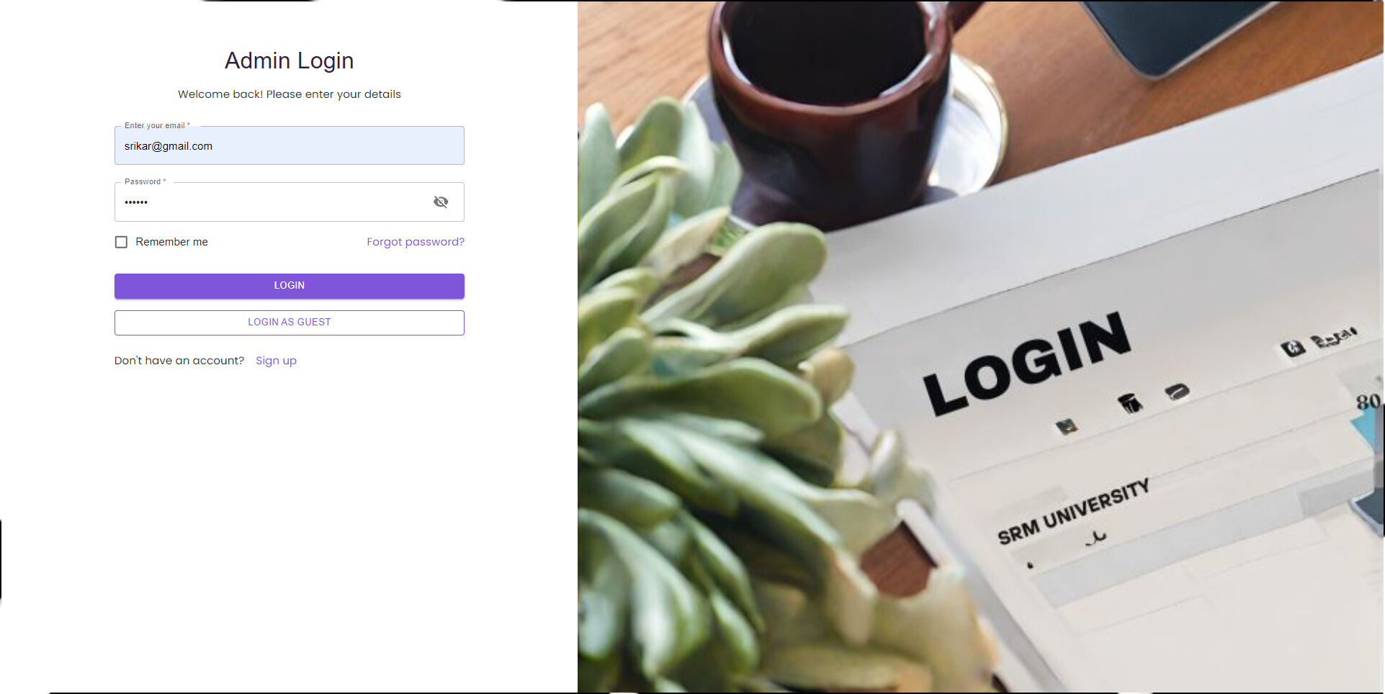
LOGIN PAGES
22

Slide 23
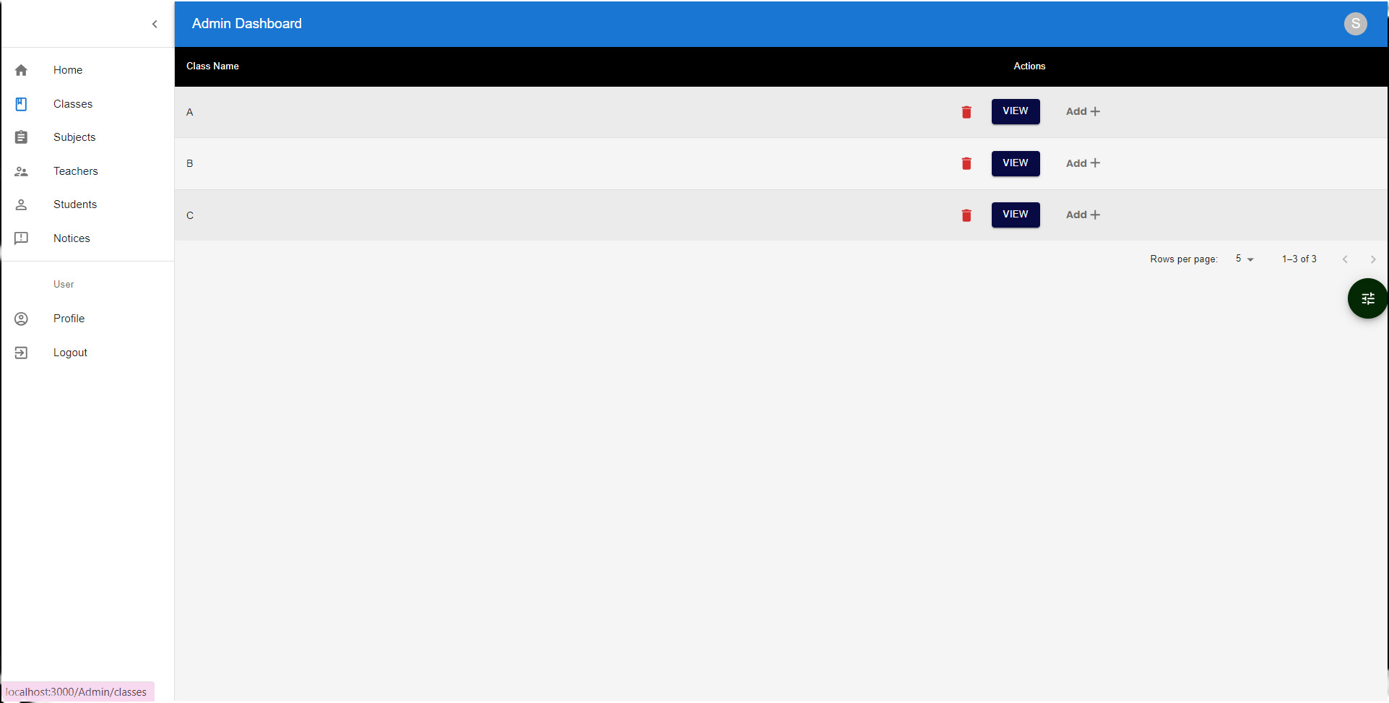
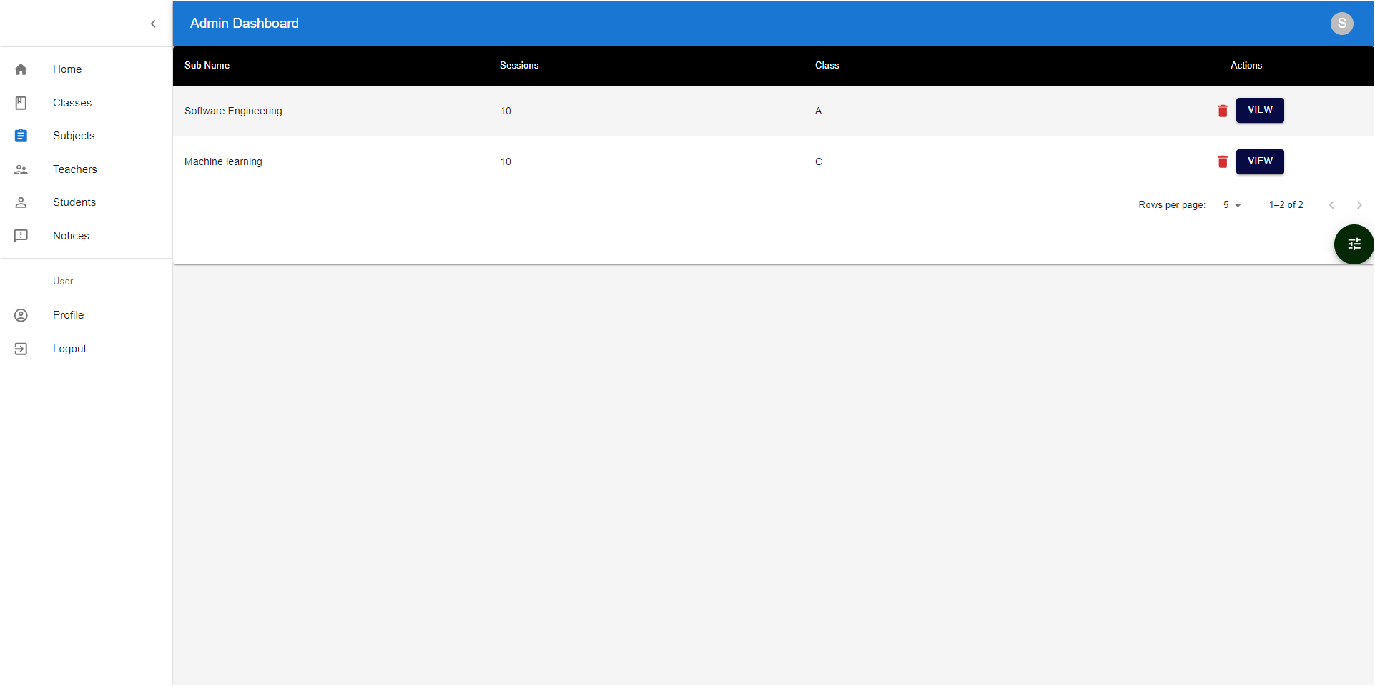
ADMIN (MANAGE CLASSES)
ADMIN (MANAGE SUBJECTS)
23

Slide 24
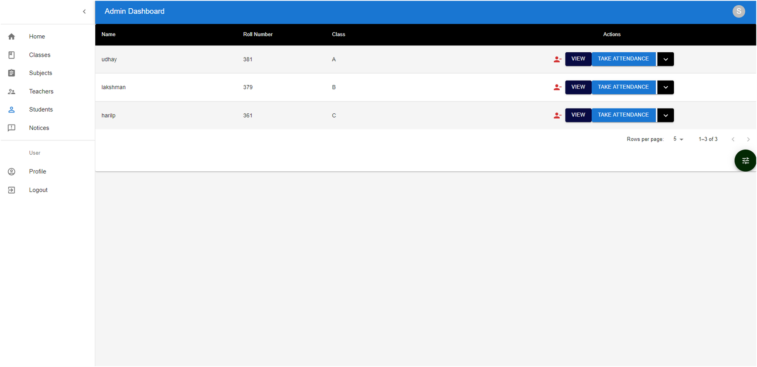
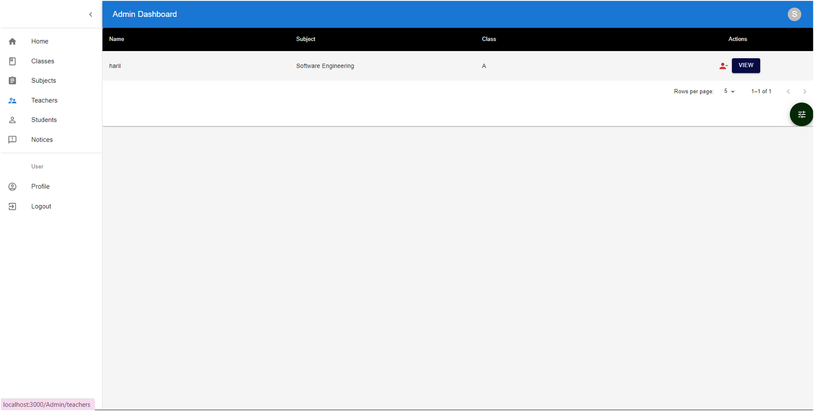
ADMIN (MANAGE STUDENTS)
ADMIN (MANAGE FACULTY)
24

Slide 25
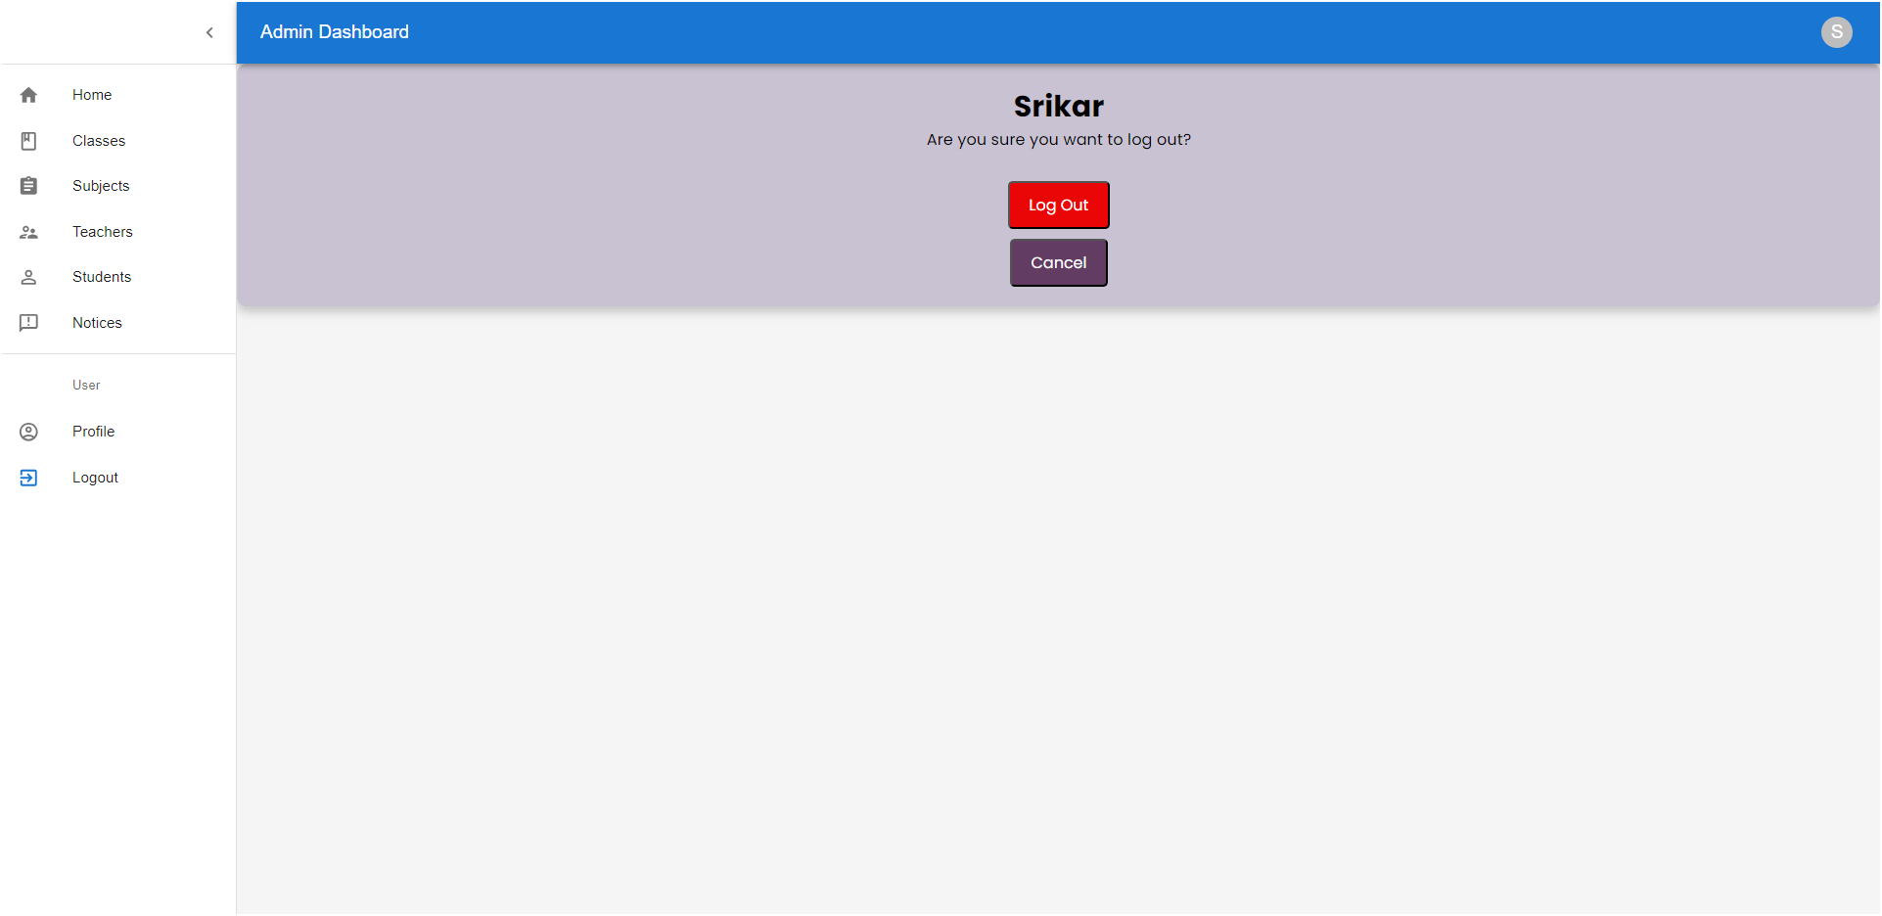
ADMIN DASHBOARD (LOGOUT)
25

Slide 26
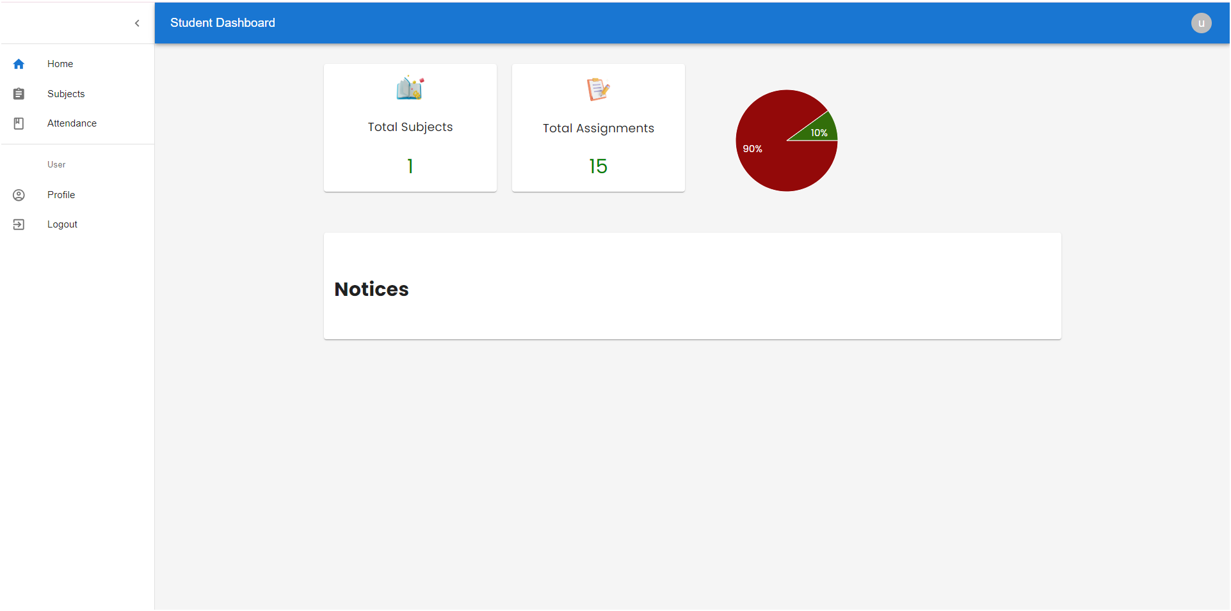
STUDENT DASHBOARD
26

Slide 27
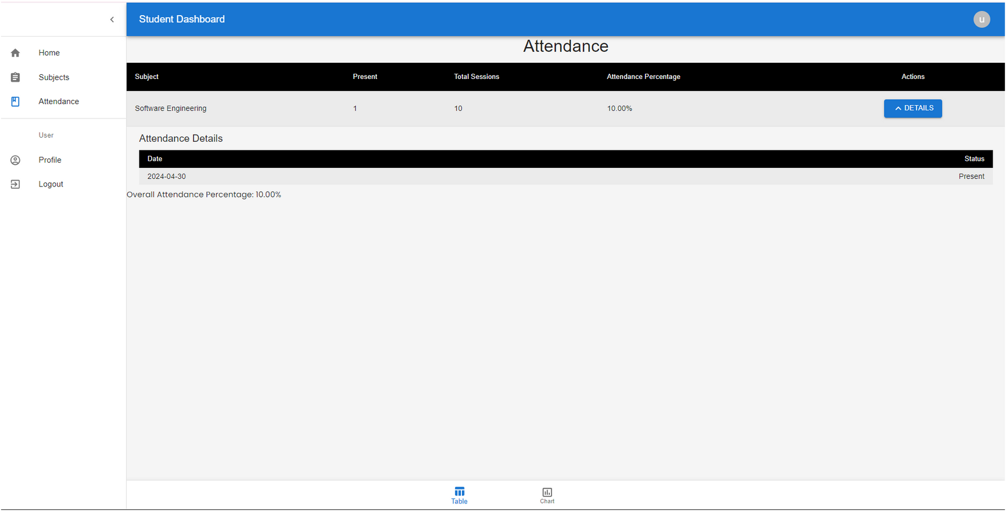
STUDENT (VIEW ATTENDANCE)
27

Slide 28
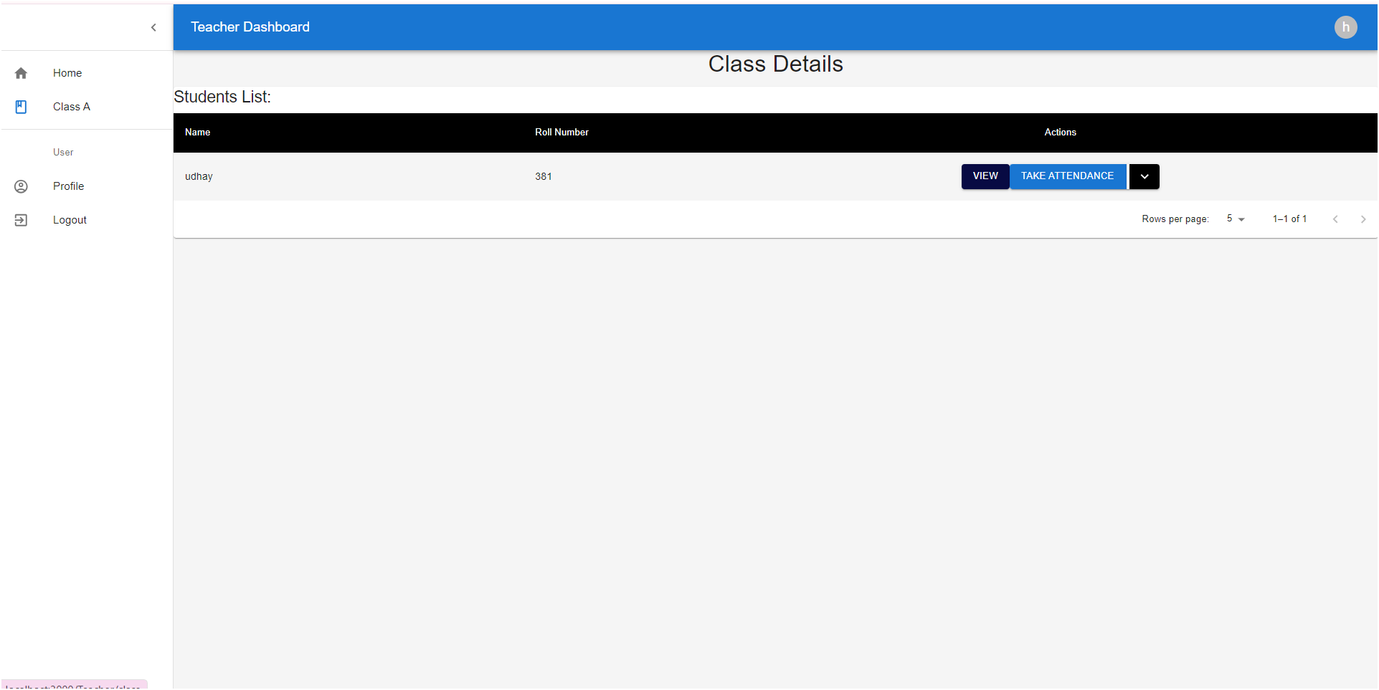
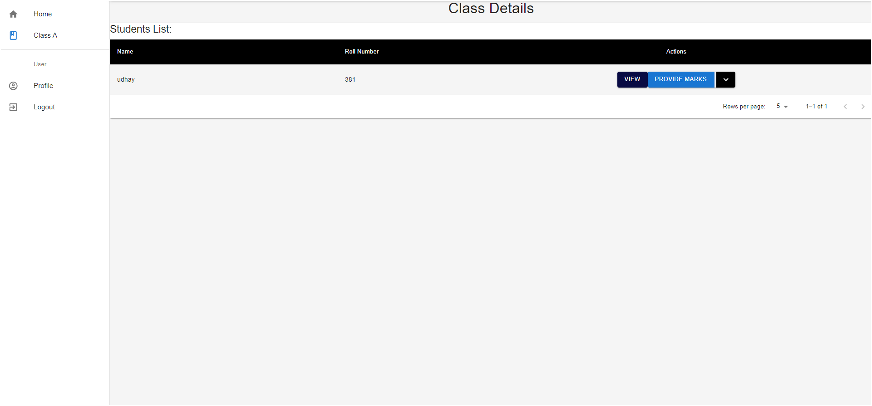
FACULTY (MARK ATTENDANCE)
FACULTY (ASSIGN MARKS)
28

Slide 29
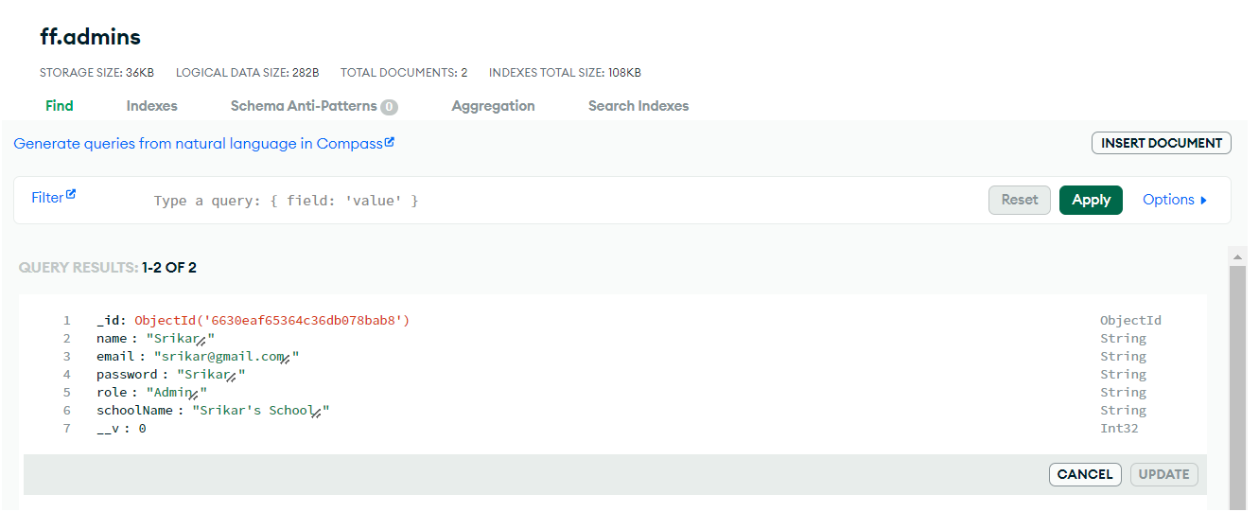
DATABASE TABLES
ADMIN DATABASE
29

Slide 30
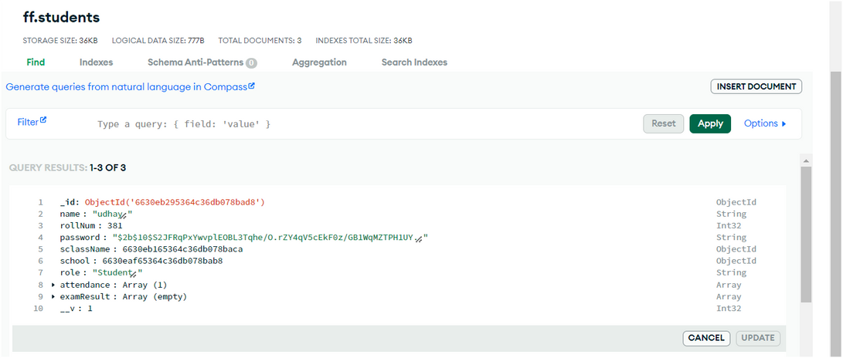
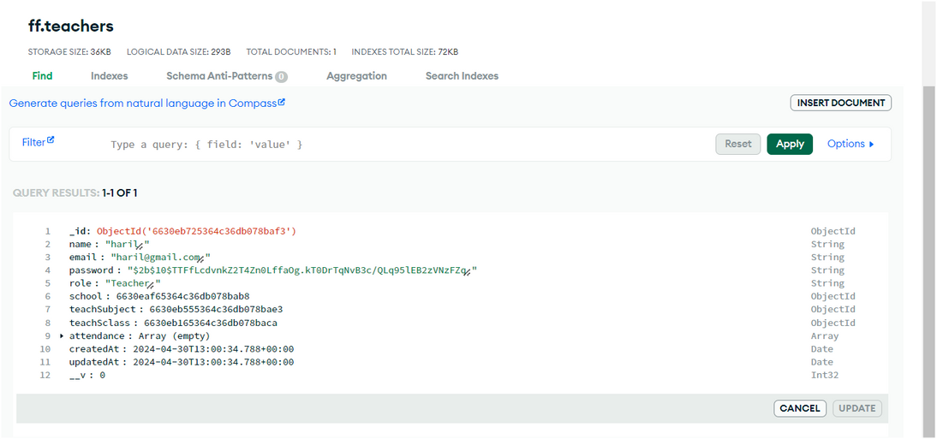
STUDENT DATABASE
TEACHER DATABASE
30

Slide 31
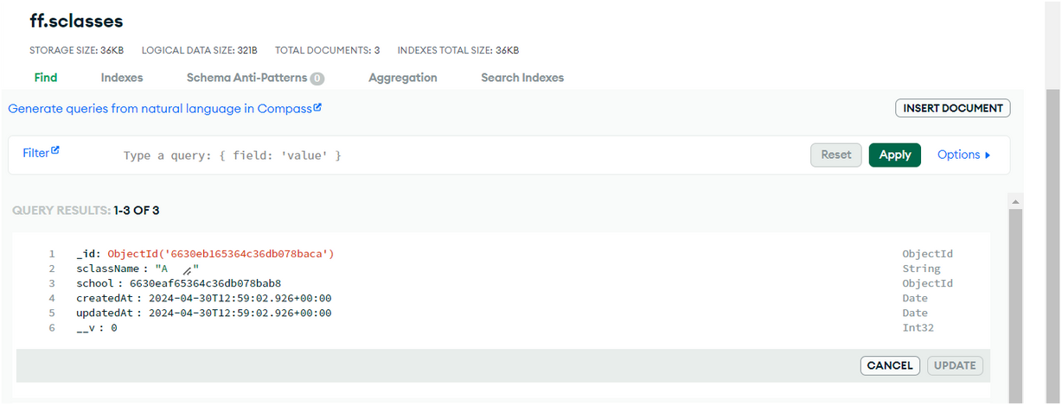
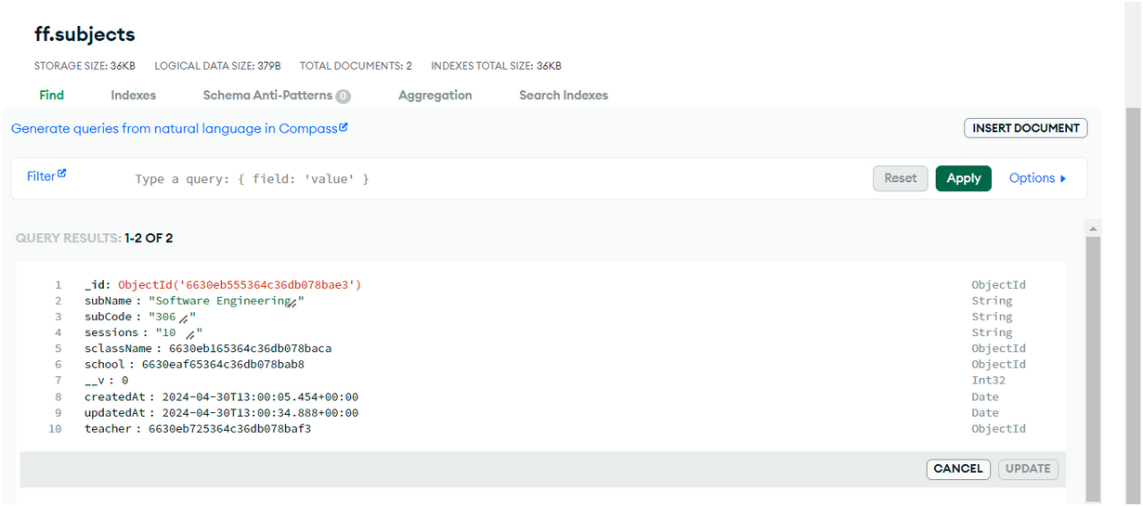
CLASSES DATABASE
SUBJECTS DATABASE
31

Slide 32


FUNCTIONAL TESTING
Login Module:
Valid Credentials Test: Verify that users can log in successfully with valid username and password combinations.
Invalid Credentials Test: Confirm that users receive appropriate error messages when attempting to log in with invalid credentials.
Case Sensitivity Test: Test whether the system distinguishes between uppercase and lowercase characters in usernames and passwords during login.
Person Entry Module:
Valid Entry Test: Verify that the admin can successfully add entries with valid data inputs.
Invalid Entry Test: Confirm that appropriate error messages are displayed when users attempt to add entries with invalid or missing data.
32

Slide 33

Duplicate Entry Test: Test whether the system prevents users from adding duplicate entries.
Database Integrity Test: Verify that added entries are correctly stored in the database.
Data Assignment Module:
Valid Marking Test: Verify that users can mark attendance and marks for students or participants accurately.
Absence Handling Test: Test the system's response to marking absences, ensuring it correctly updates attendance records.
Attendance Reports Test: Test the generation of attendance reports to ensure accuracy and completeness.
33

Slide 34
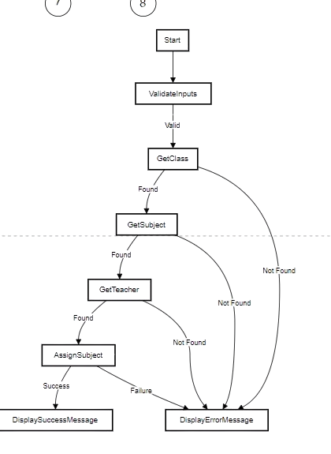
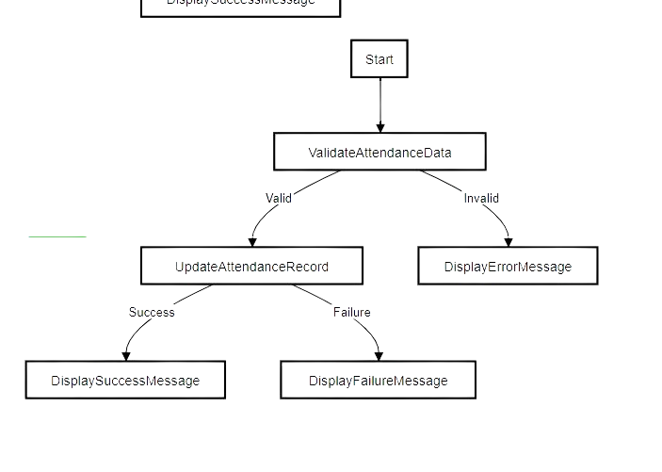
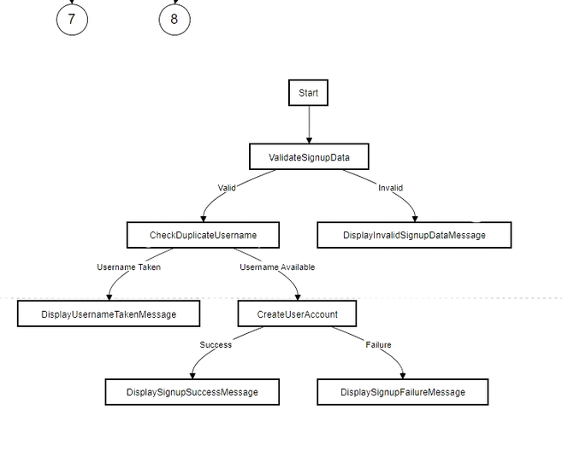
PATH COVERAGE TESTING
SIGN UP MODULE
ALLOCATE FACULTY MODULE
MARKING ATTENDACNE MODULE
34

Slide 35



NON FUNCTIONAL TESTING
PERFORMANCE TESTING
USABILITY TESTING
COMPATABILITY TESTING
Load Testing: Simulate multiple users concurrently accessing the system to assess its performance under normal and peak loads.
Response Time Testing: Measure the response time of each module under different load conditions to ensure timely user interactions.
User Interface Testing: Evaluate the clarity, intuitiveness, and consistency of the user interface across different modules.
Navigation Testing: Verify that users can navigate through different modules and functionalities efficiently, with minimal confusion
Browser Compatibility Testing: Verify that the application functions correctly across different web browsers and versions.
Operating System Compatibility Testing: Test the application on various operating systems (e.g., Windows, macOS, Linux) to ensure compatibility.
01
02
03
35

Slide 36

CONCLUSION
The University Management System (UMS) project marks a significant milestone in modernizing administrative processes within educational institutions. Modular design, responsive interfaces, and seamless backend integration ensure efficient data management and streamlined operations. Security and efficiency remain paramount throughout the UMS's development lifecycle, with protocols in place for input validation, authentication, access control, and performance optimization. These measures safeguard data integrity, user confidentiality, system dependability. Finally, through rigorous testing and iterative development, we've created a robust system proficient in user authentication, course management, and reporting functionalities, ensuring efficiency and reliability for all stakeholders.
36

Slide 37

LIMITATIONS AND FUTURE WORK
The university management system project faces notable limitations by not incorporating fee payment functionality, integrating a parent portal with access to fee and student databases, and lacking a mechanism for collecting faculty feedback. Moreover, the inability to gather faculty feedback within the system might impede efforts to assess teaching quality and make necessary improvements. Addressing these limitations through alternative solutions or clear communication with stakeholders is crucial
Future work involves enhancing analytics capabilities for deeper insights, developing dedicated mobile applications for wider accessibility, and exploring blockchain integration for enhanced data security and transparency. Additionally, integrating AI-driven chatbots and continuous testing practices will further elevate the UMS's functionality, user experience, and overall system performance.
37

